Slide 1
Baseball “Infield Shift”
Project 1, Team G
Elliot Graf
William Hibner
Larry VonDracek II

Slide 2
Motivation & Hypothesis:
Has the popularity of the “infield shift” had an impact on major league baseball?
Does Major League Baseball (MLB) need to consider a rule change to eliminate the “infield shift”?
Are teams that employ the “infield shift” more successful?
Null Hypothesis:
The “infield shift” has no affect on baseball?

Slide 3
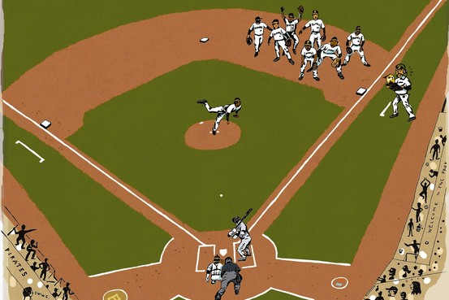
What is the Infield Shift?
The infield shift is used primarily against left-handed batters. It is designed to protect against base hits pulled hard into the gaps between the fielders on one side.
Source: Wikipedia

Slide 4
Initial Research Questions:
Are teams scoring less since the “infield shift” become popular in year 2014?
Has the “infield shift” affected bunting %?
Has the “infield shift” impacted team batting metrics?
Has the “infield shift” impacted team pitching metrics?
Has the “infield shift” impacted team fielding metrics?

Slide 5
Data Sources:
Data World baseball csv - https://data.world/mike-p/baseball-data-from-lahman-dataset-2018
Fangraphs: https://www.fangraphs.com/

Slide 6
Data Shortcomings:
No known specific “infield shift” statistics exist
No known data comparisons for “infield shift”
Team was not able to find a metric that covered bunting

Slide 7
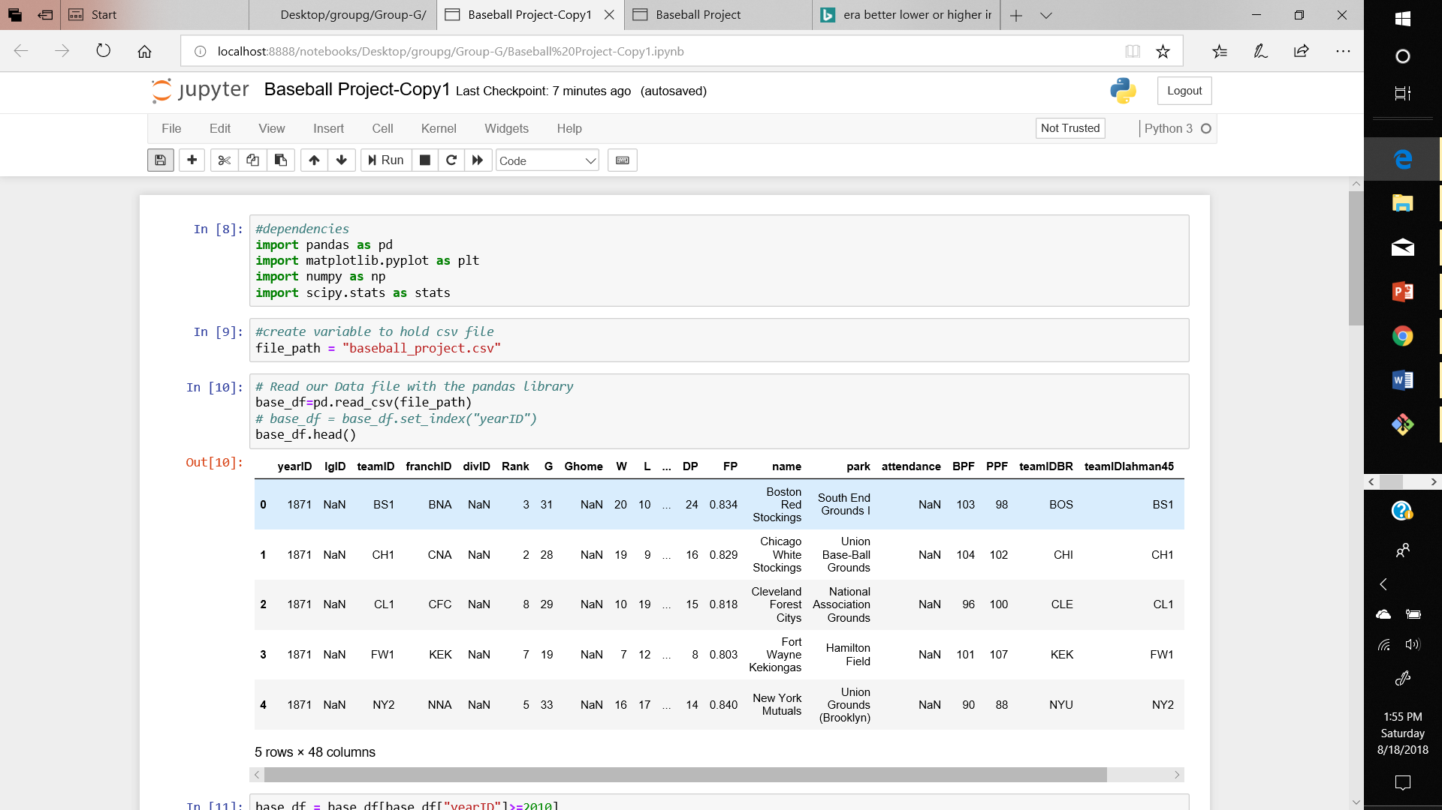
Jupyter ScreenShot

Slide 8
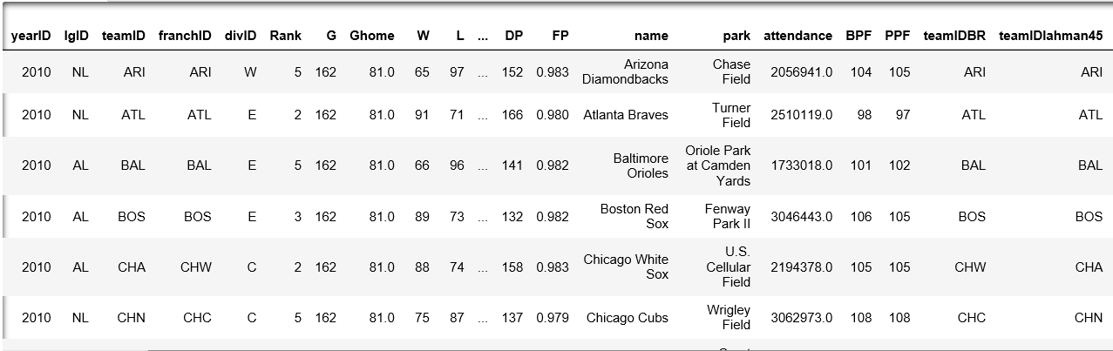
Data Set Cleanup & Exploration:

Slide 9
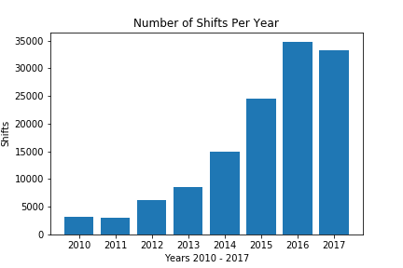
Data Analysis: Number of Shifts Per Year
Null hypothesis: Average number of shifts after 2014 is not different than average number of shifts between 2010 – 2014.
We calculated the average number of shifts from 2010 to 2013 and 2014 to 2017 and performed a t-test. (t statistic = -4.8, p value = .01)
Conclusion: There is not sufficient evidence to reject the null hypothesis.
Source: Fangraphs: https://www.fangraphs.com/

Slide 10
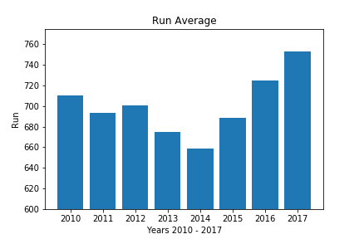
Data Analysis: Run Average
Runs Average: Average number of MLB runs per year.
Null hypothesis: Average number of runs after 2014 is not different than average number of runs between 2010 – 2014.
We calculated the average number of runs from 2010 to 2013 and 2014 to 2017 and performed a t-test. (t statistic = -.5, p value = .64)
Conclusion: There is not sufficient evidence to reject the null hypothesis.
Source: https://data.world/mike-p/baseball-data-from-lahman-dataset-2018

Slide 11
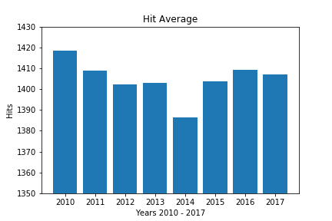
Data Analysis: Hits Average
Hits Average: Average number of MLB hits per year where batter safely gets on base.
Null hypothesis: Average number of hits after 2014 is not different than average number of hits between 2010 – 2014.
We calculated the average number of hits from 2010 to 2013 and 2014 to 2017 and performed a t-test. (t statistic = 1.0, p value = .35)
Conclusion: There is not sufficient evidence to reject the null hypothesis.
Source: https://data.world/mike-p/baseball-data-from-lahman-dataset-2018

Slide 12
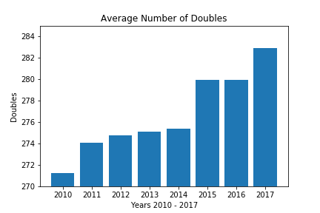
Data Analysis: Doubles (Hits with power)
Doubles Average: Average number of MLB hits where batter advances to second base.
Null hypothesis: Average number of doubles after 2014 is not different than average number of doubles between 2010 – 2014.
We calculated the average number of doubles from 2010 to 2013 and 2014 to 2017 and performed a t-test. (t statistic = 1.0, p value = .35)
Conclusion: There is not sufficient evidence to reject the null hypothesis.
Source: https://data.world/mike-p/baseball-data-from-lahman-dataset-2018

Slide 13
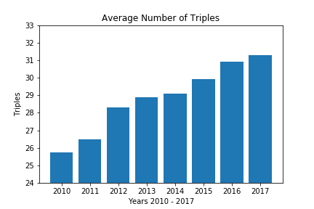
Data Analysis: Triples (Hits with power)
Triples Average: Average number of MLB hits where batter advances to third base.
Null hypothesis: Average number of triples after 2014 is not different than average number of doubles between 2010 – 2014.
We calculated the average number of triples from 2010 to 2013 and 2014 to 2017 and performed a t-test. (t statistic = -1.1, p value = .32)
Conclusion: There is not sufficient evidence to reject the null hypothesis.
Source: https://data.world/mike-p/baseball-data-from-lahman-dataset-2018

Slide 14
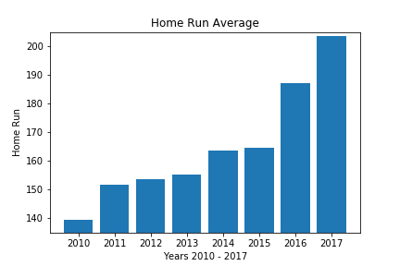
Data Analysis: Home Run (Hits with power)
Home run average: Average number of MLB hits where batter hits ball out of the park.
Null hypothesis: Average number of home runs after 2014 is not different than average number of doubles between 2010 – 2014.
We calculated the average number of home runs from 2010 to 2013 and 2014 to 2017 and performed a t-test. (t statistic = -1.2, p value = .31)
Conclusion: There is not sufficient evidence to reject the null hypothesis.
Source: https://data.world/mike-p/baseball-data-from-lahman-dataset-2018

Slide 15
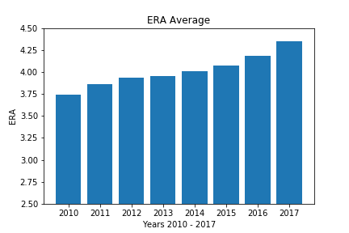
Data Analysis: ERA (Metric for Pitchers)
ERA: Average number of MLB runs attributed to teams’ pitching staff (Earned run average)
Null hypothesis: ERA after 2014 is not different than ERA between 2010 – 2014.
We calculated the average number of home runs from 2010 to 2013 and 2014 to 2017 and performed a t-test. (t statistic = -.61, p value = .57)
Conclusion: There is not sufficient evidence to reject the null hypothesis.
Source: https://data.world/mike-p/baseball-data-from-lahman-dataset-2018

Slide 16
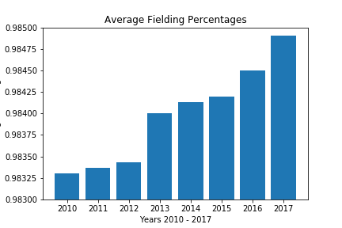
Data Analysis: Fielding Average
Fielding average: The % of times a defensive player properly handles a batted or thrown ball. It is calculated by the sum of putouts and assists divided by the number of total chances (putouts + assists + errors)
Null hypothesis: Fielding average after 2014 is not different than fielding average between 2010 – 2014.
We calculated the MLB fielding average from 2010 to 2013 and 2014 to 2017 and performed a t-test. (t statistic = -1.1, p value = .32)
Conclusion: There is not sufficient evidence to reject the null hypothesis.
Source: https://data.world/mike-p/baseball-data-from-lahman-dataset-2018

Slide 17
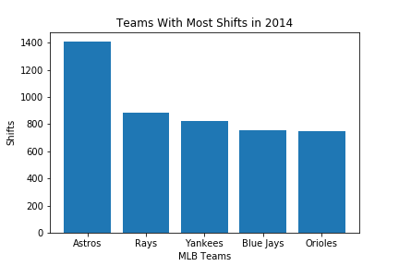
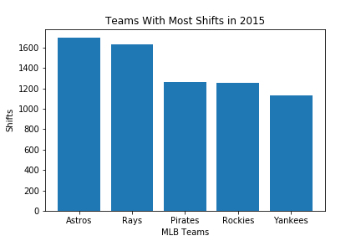
Do teams that shift have more success?
name | 2014 Division Rank | 2014 League Winner? | 2014 World Series Winner?
Houston Astros | 4 | N | N
Tampa Bay Rays | 4 | N | N
New York Yankees | 2 | N | N
Toronto Blue Jays | 3 | N | N
Baltimore Orioles | 1 | N | N
name | 2015 Division Rank | 2015 League Winner? | 2015 World Series Winner?
Houston Astros | 2 | N | N
Tampa Bay Rays | 4 | N | N
New York Yankees | 2 | N | N
Pittsburgh Pirates | 2 | N | N
Colorado Rockies | 5 | N | N
Source: https://data.world/mike-p/baseball-data-from-lahman-dataset-2018 and Fangraphs: https://www.fangraphs.com/

Slide 18
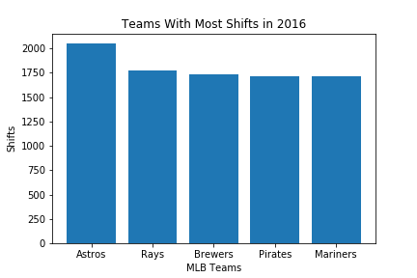
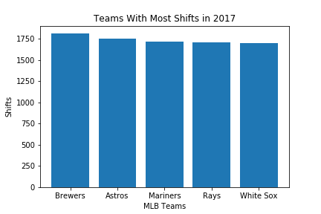
Do teams that shift have more success?
name | 2016 Division Rank | 2016 League Winner? | 2016 World Series Winner?
Houston Astros | 3 | N | N
Tampa Bay Rays | 5 | N | N
Milwaukee Brewers | 4 | N | N
Seattle Mariners | 2 | N | N
Pittsburgh Pirates | 3 | N | N
name | 2017 Division Rank | 2017 League Winner? | 2017 World Series Winner?
Houston Astros | 1 | Y | Y
Tampa Bay Rays | 3 | N | N
Milwaukee Brewers | 2 | N | N
Seattle Mariners | 3 | N | N
Chicago White Sox | 4 | N | N
Source: https://data.world/mike-p/baseball-data-from-lahman-dataset-2018 and Fangraphs: https://www.fangraphs.com/

Slide 19
Discussion:
Findings
Failed to reject the null hypothesis. There is not enough evidence to supports the conclusion that the “infield shift” has had an impact on baseball.
Teams that rely on the “infield shift” do not appear to have more success.
Based on the data, it does not appear that the MLB needs to make any changes to the rules.

Slide 20
Post Mortem
Baseball has many straight forward statistics i.e. batting average, ERA, etc….There is no “infield shift” statistic.
Some databases are better than others. Fangraphs database was found late and was very useful.
Did it impact the game to the point that rules need to be changed?
Some of our initial questions like bunting % were eliminated in our work due to lack of data.

Slide 21
Questions?

